Slide 1
Predicting House Prices
Group 3
Seungmo Choi (202324425)
ABDULLAH WAN MUHAMAD HANIFF FIKRY (202332524)
Seongsik Jeong (202324423)
Seokyeom Park (202128564)
David Riemer(202332590)

Slide 2
Purpose of project
Model for prediction
Competition | House Prices – Advanced Regression Techniques
Goal | Prediction
Data format | CSV
Num of Data Columns | 81
Using Model | Random Forest XGBoost Light GBM K-mean Clustering GMM Clustering Agglomerative Clustering
Performance | RMSE
Pre-process Data
Clustering
Only Model
Apply Model
Compare the performance

Slide 3
Metheodology

Slide 4
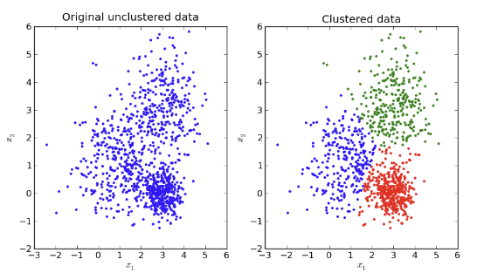
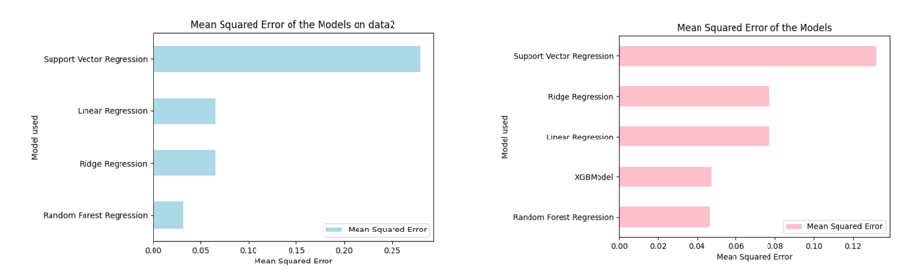
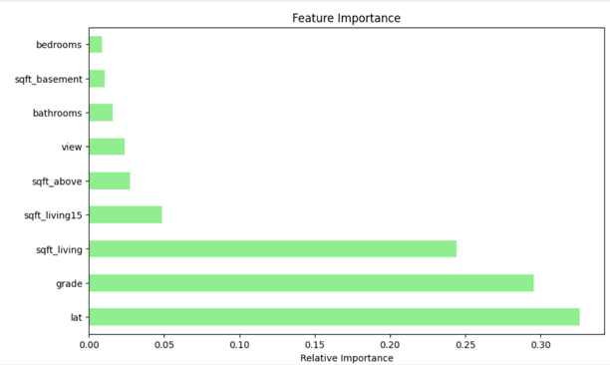
Data Preprocessing
Data Clustering &
Model selection
Model Evaluation
Choose Kaggle Data
House sales in King County
The dataset 2014~2015
Data Clustering
Evaluation by RMSE
Cluster & Non-Cluster data set
Data Preprocessing
Check & Adjusting objective value
Check Null Values
Visualizing Correlation
Compare Feature Importance
Model Selection
Liner Regression
Random Forest
XGBoost
Ridge
SVR
Set Database

Slide 5
preprocessing

Slide 6
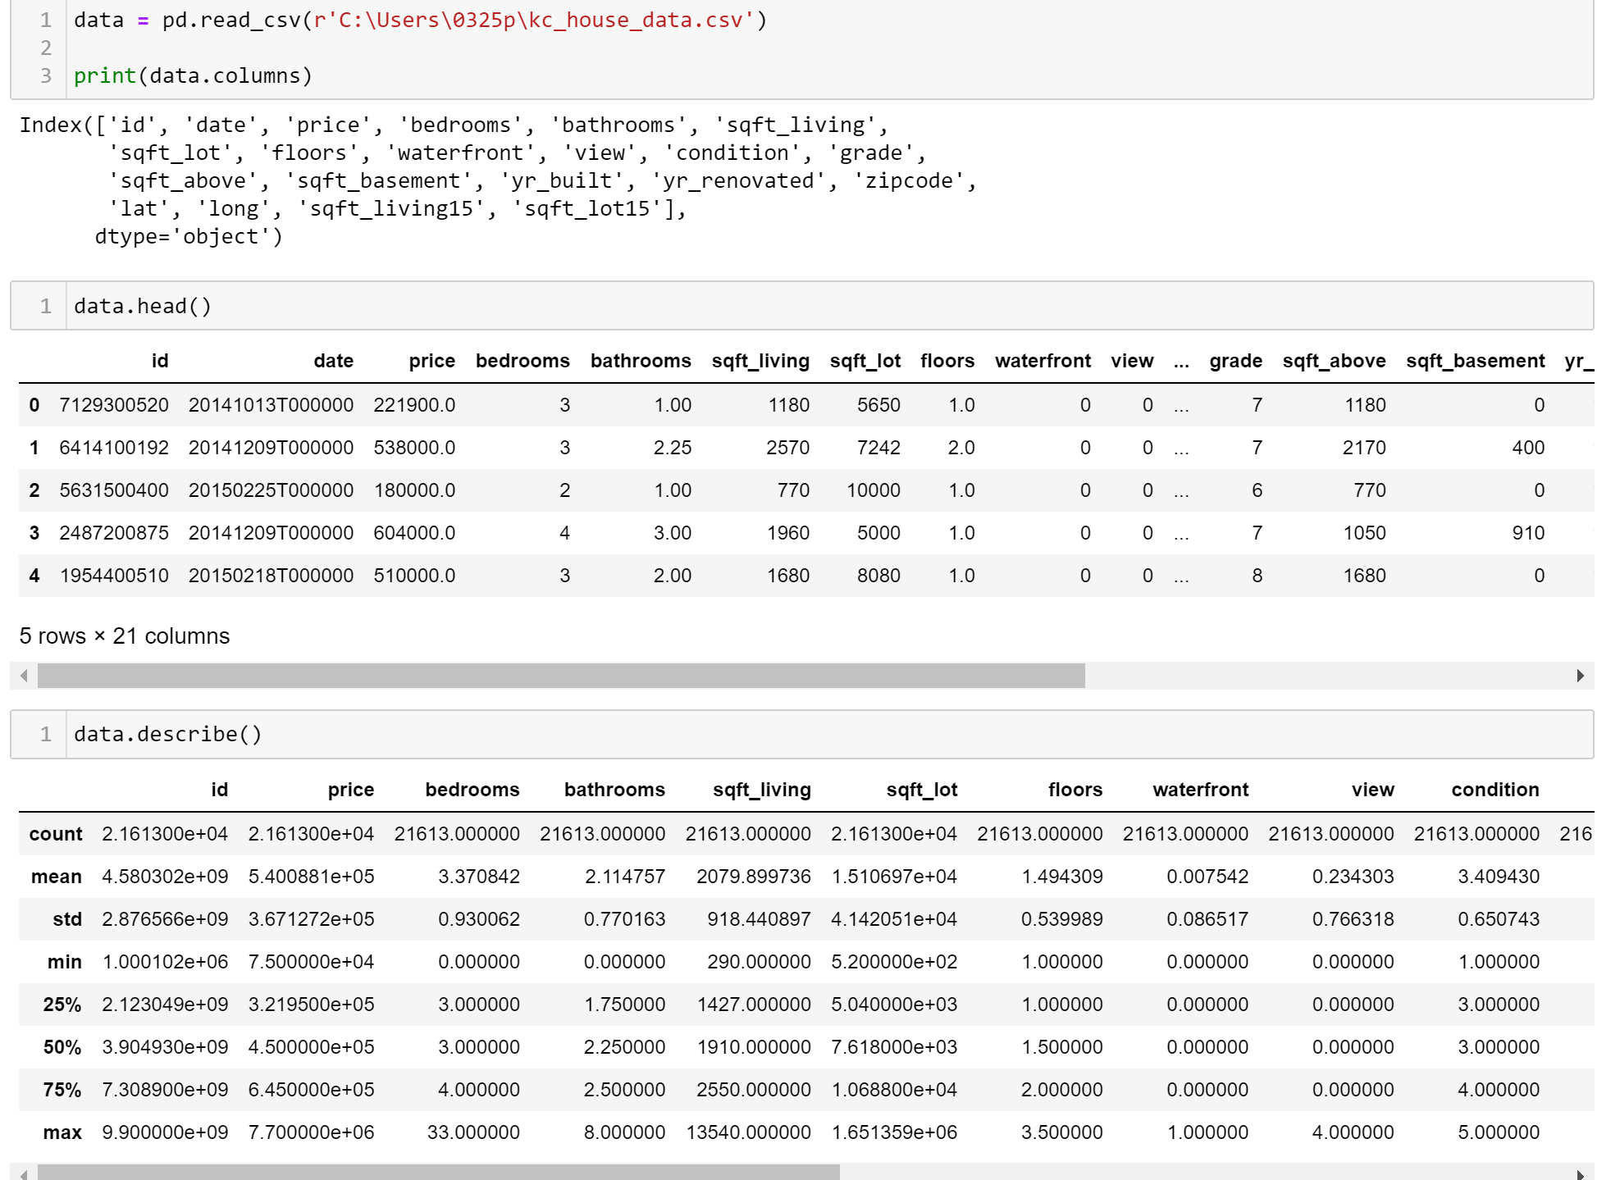
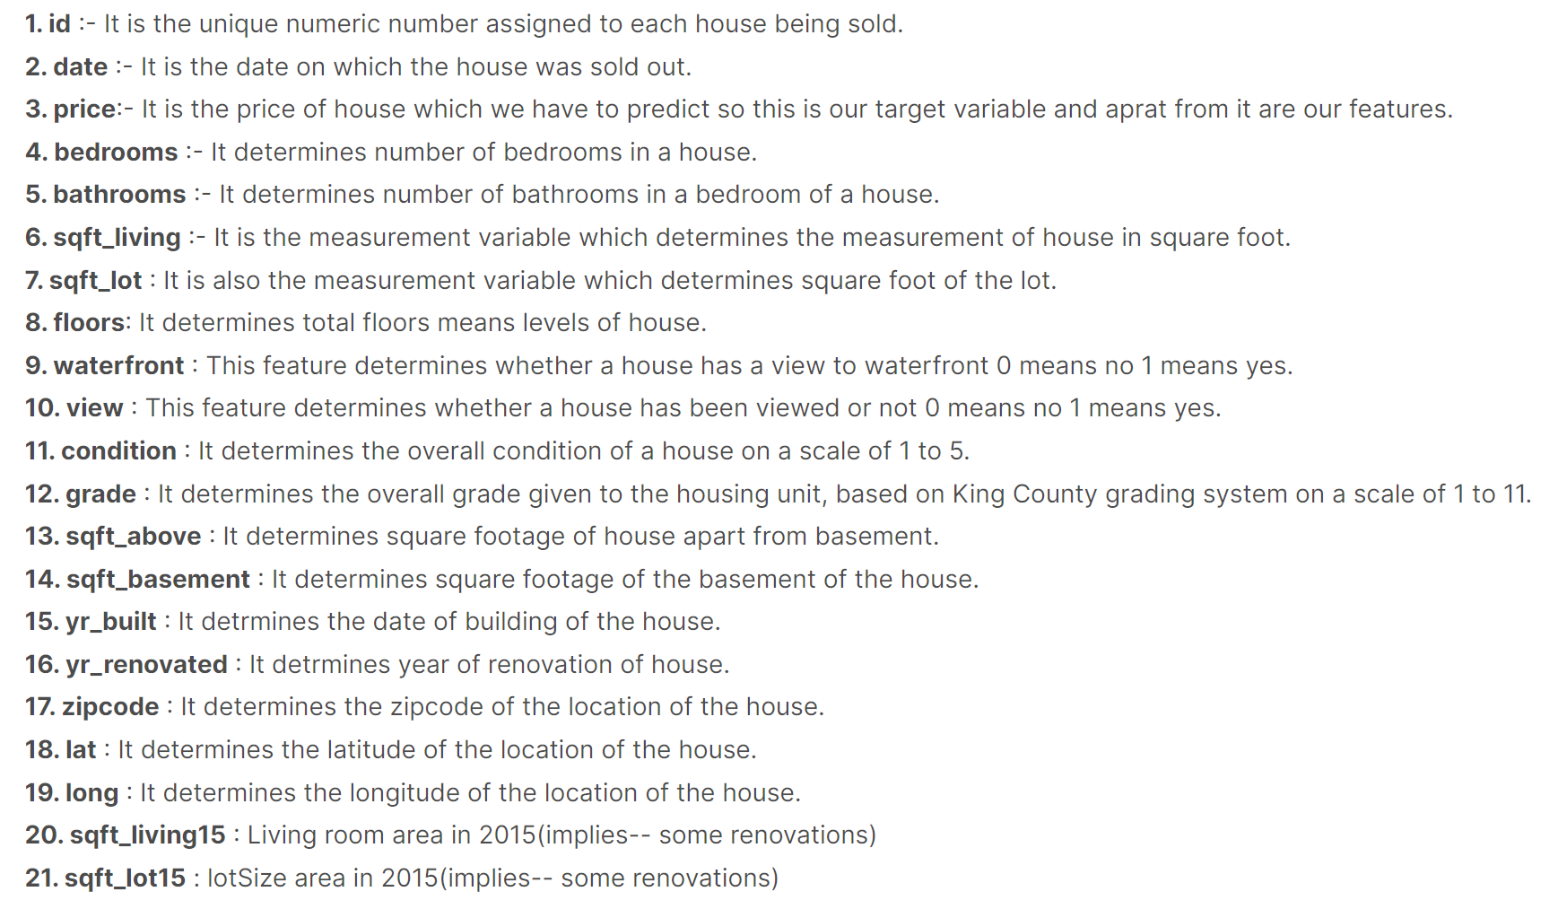
Feature information

Slide 7
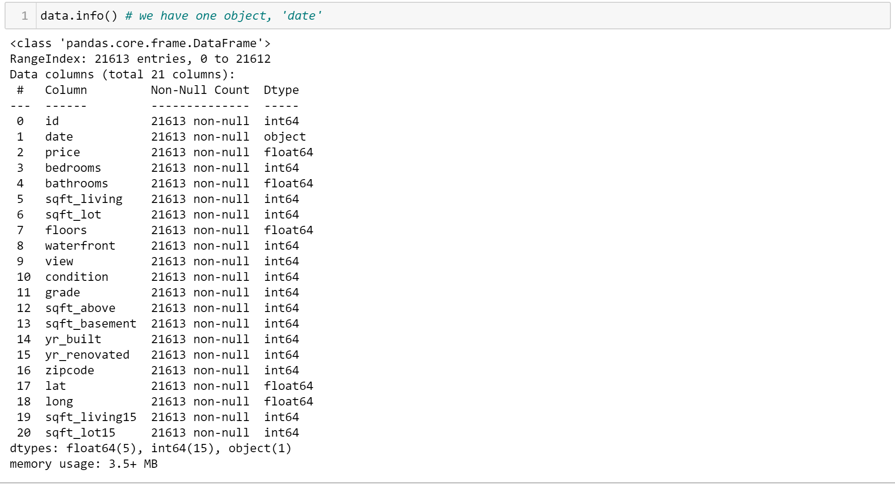
Checking object values
Feature, ‘date’ contains object value.

Slide 8
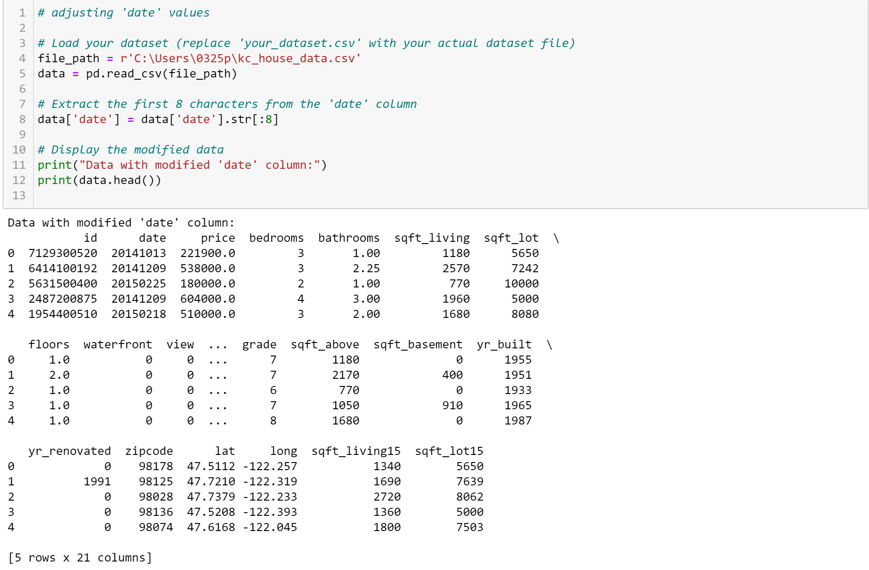
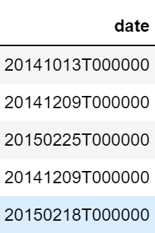
Adjusting object value
We removed T000000 part in order to present the dates only.

Slide 9
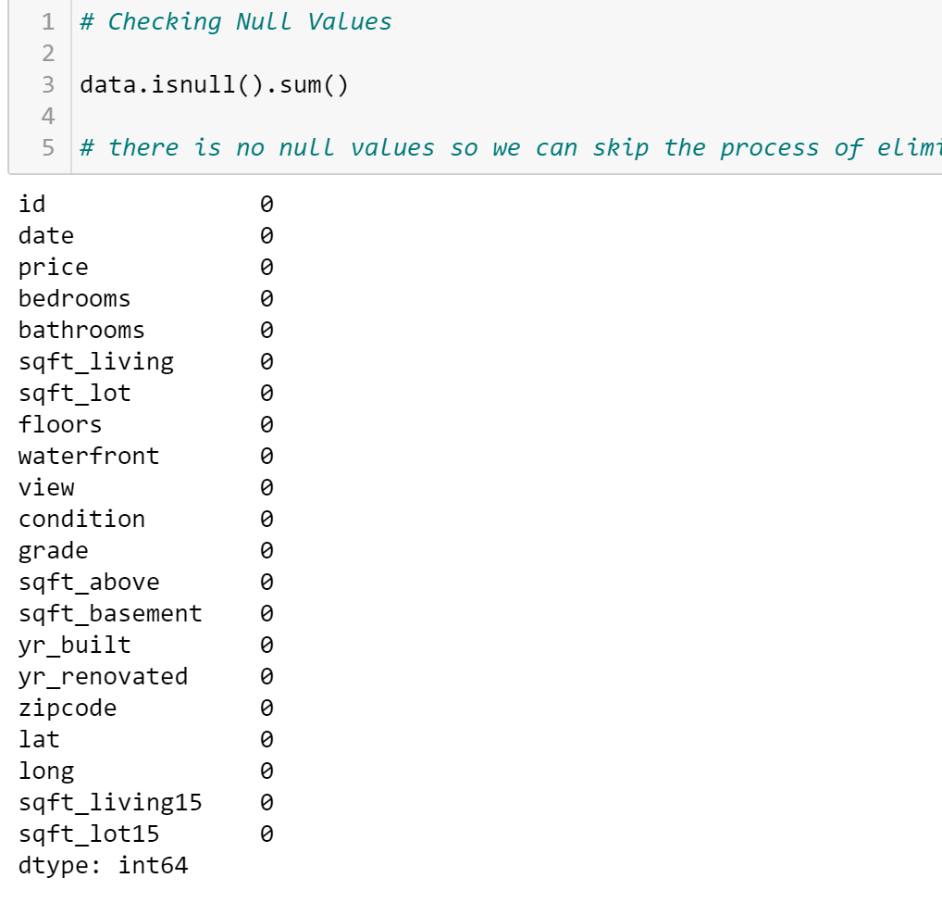
Checking null values
There was no null values, so we do not have to adjust the data anymore

Slide 10
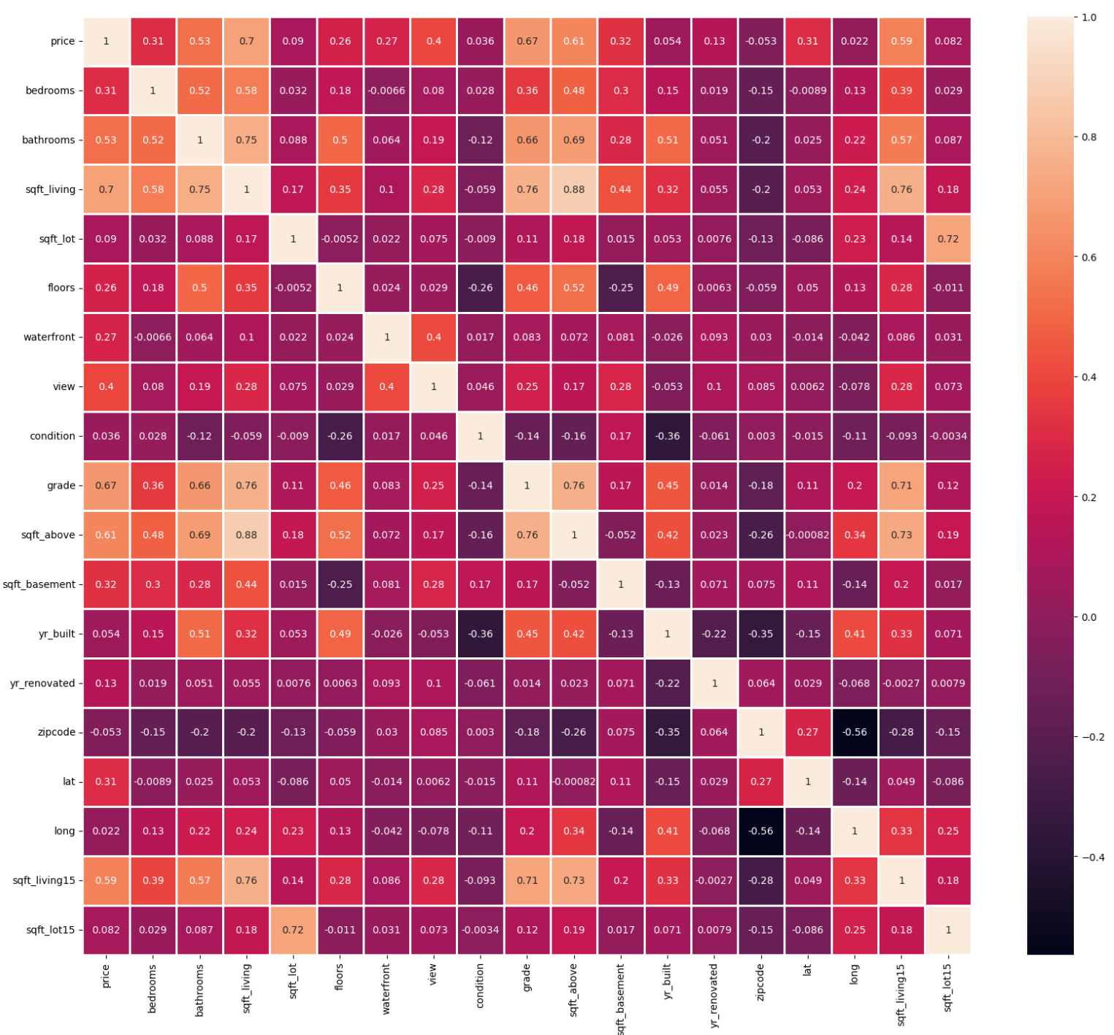
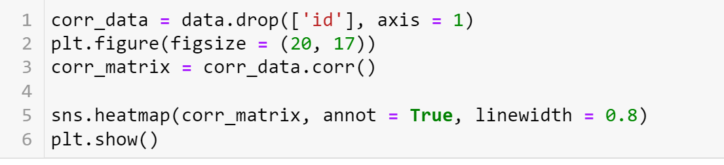
Visualizing Correlations

Slide 11
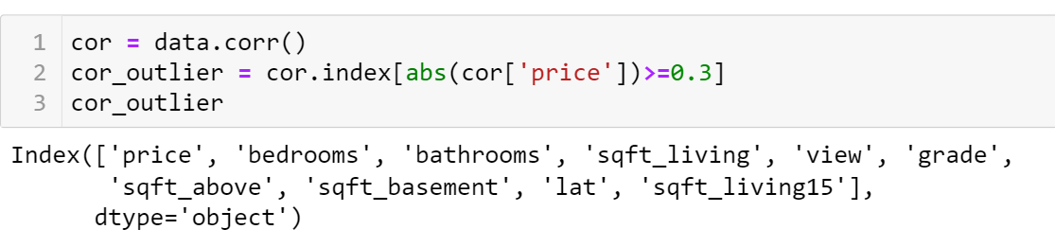
Dropping features
We decided to remove features which have under 0.3 correlation with ‘price’

Slide 12
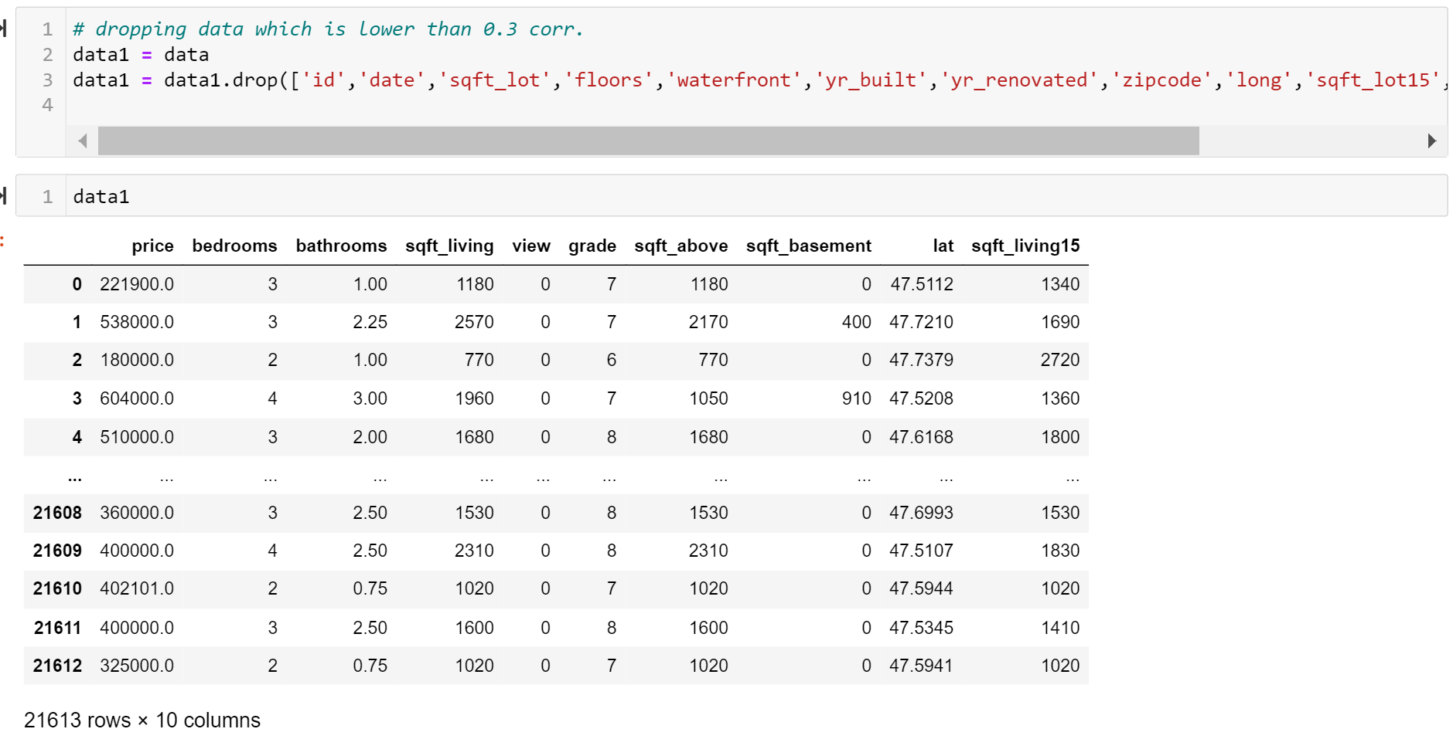
We have dropped following features (data1)
Id
Date
Sqft_lot
Floors
Waterfront
Yr_built
Yr_renovated
Zipcode
Long
Sqft_lot15
Condition

Slide 13
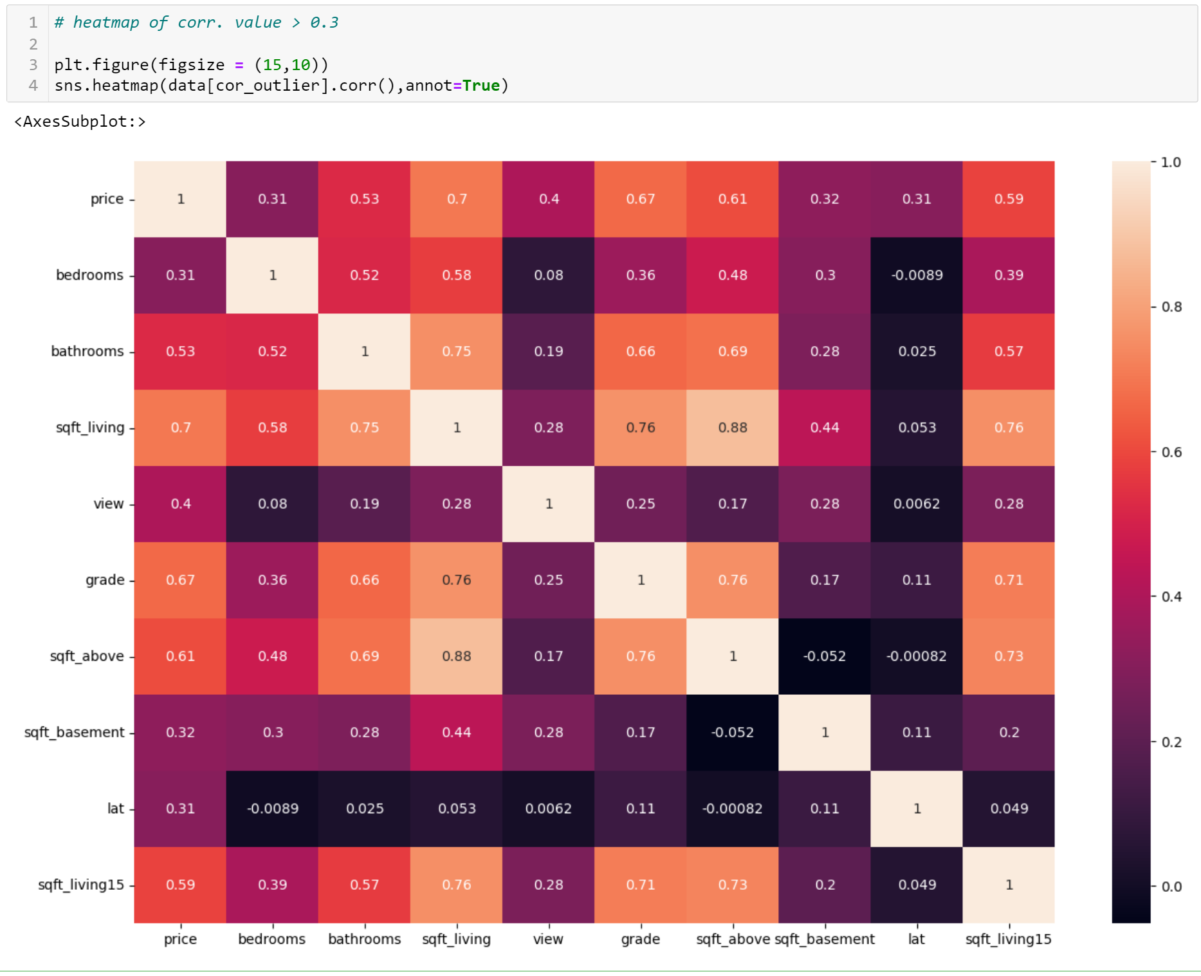
New heatmap

Slide 14
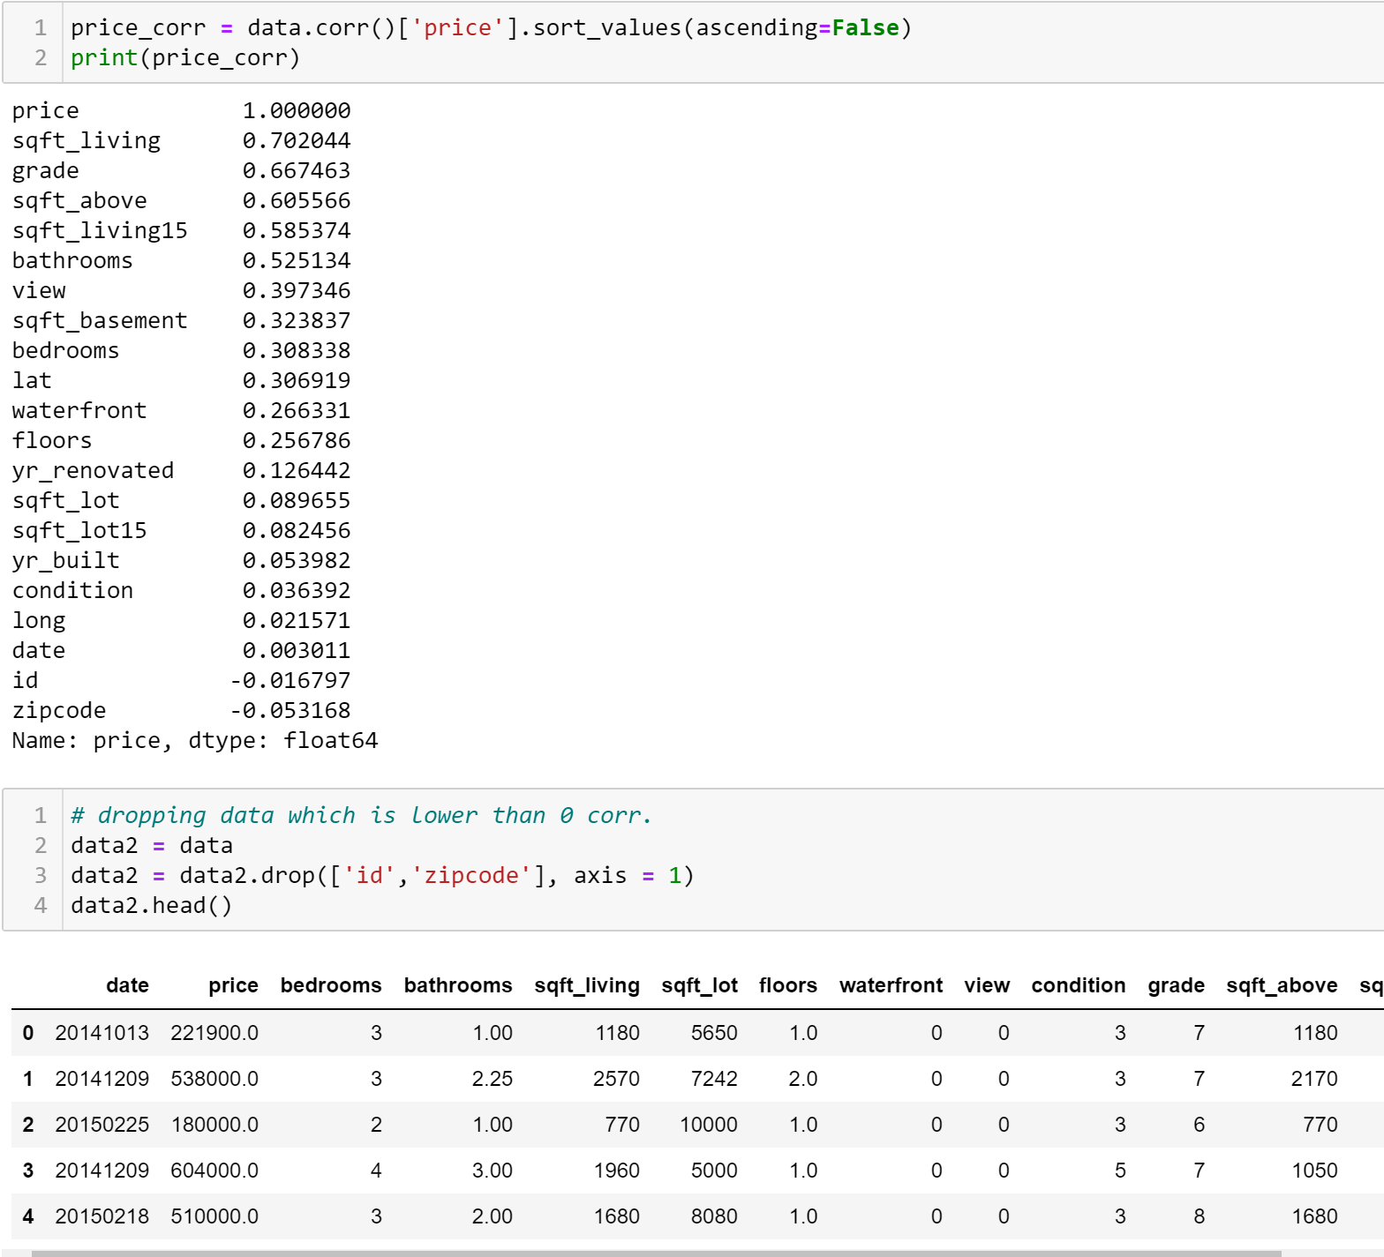
Making second data
We have dropped features which have under 0 correlation with ‘price’
Dropped features:
Id
Zipcode

Slide 15
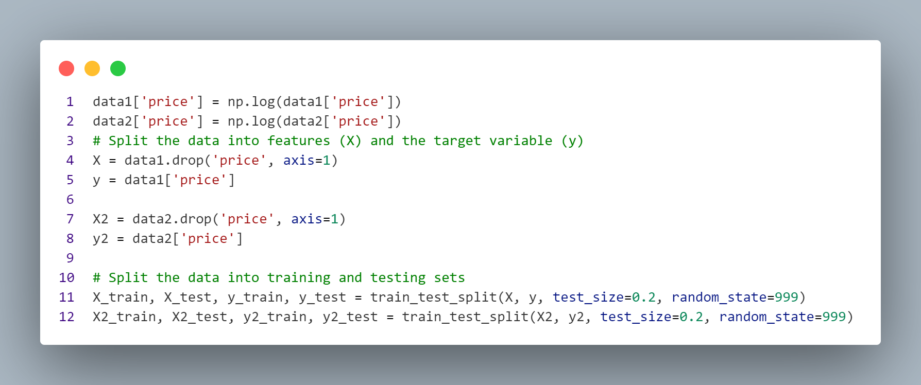
Splitting the DATA
We do this for both data1 and data2

Slide 16
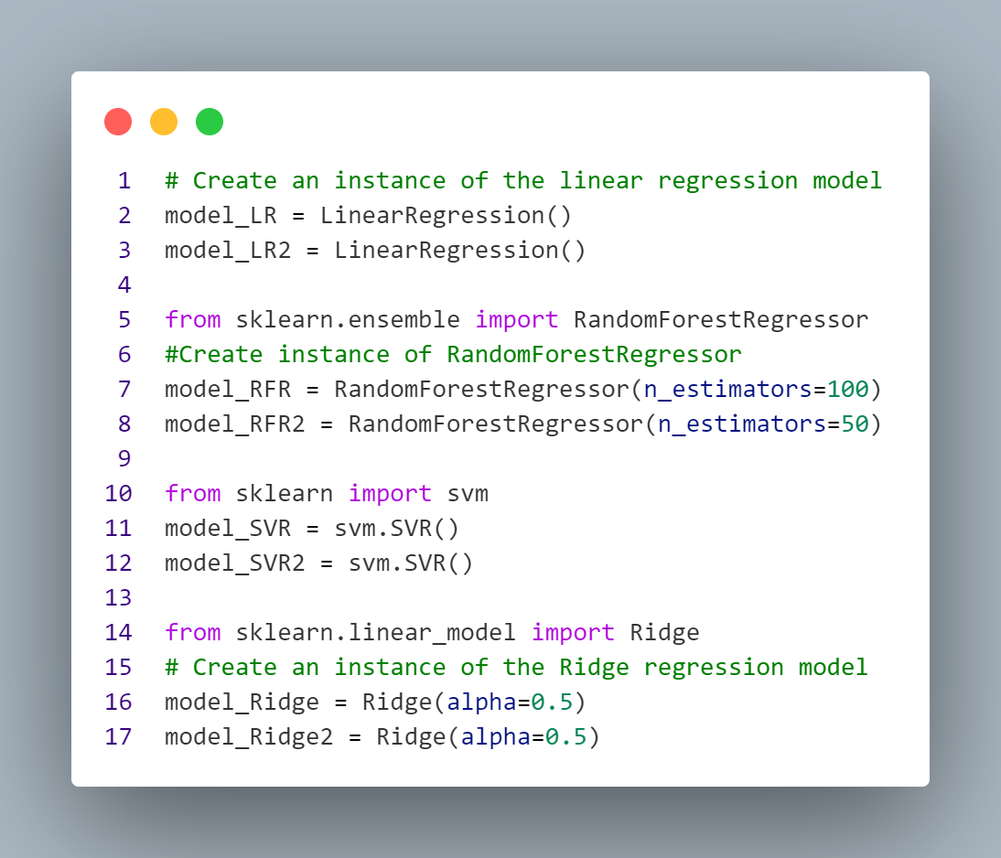
Creating the models

Slide 17
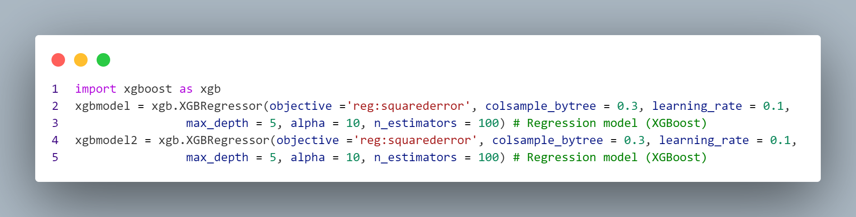
Creating the models

Slide 18
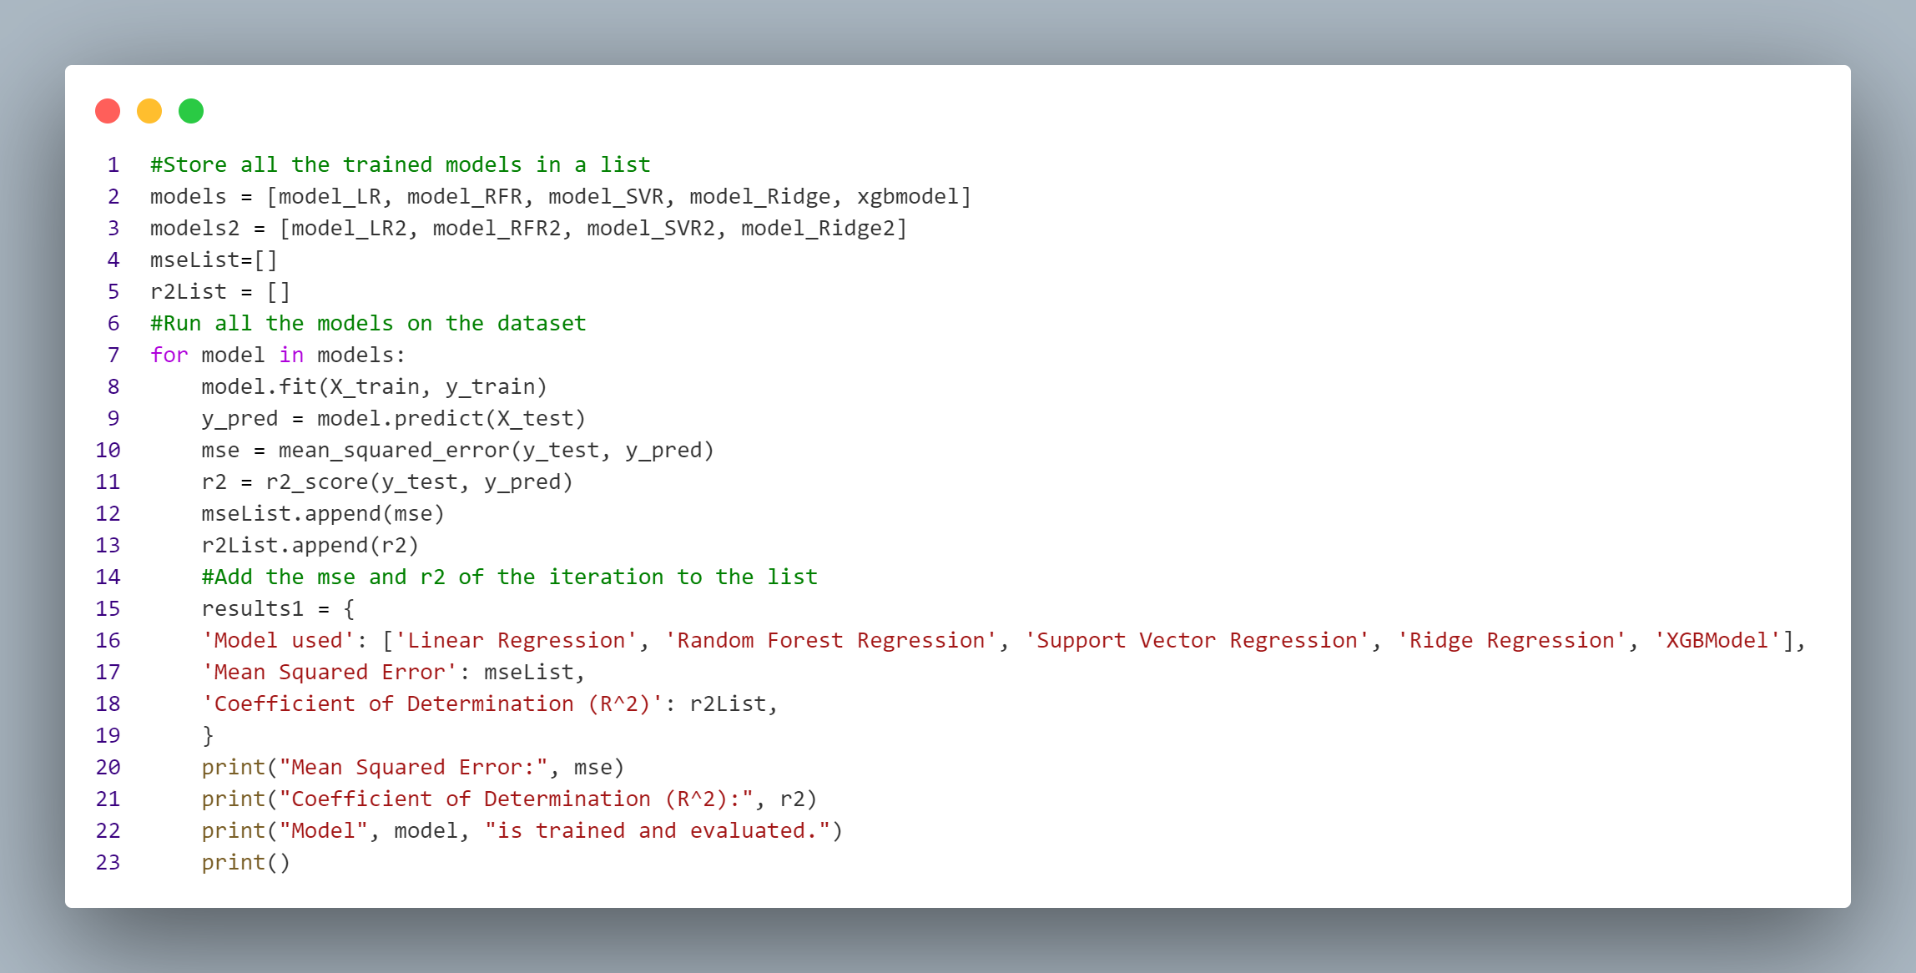
Training and applying the models

Slide 19
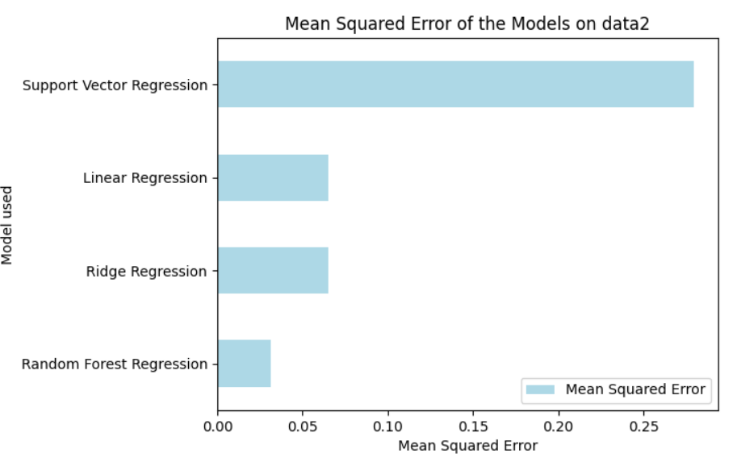
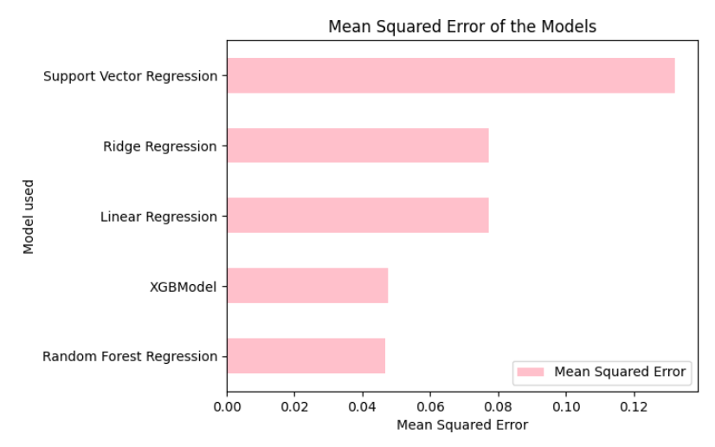
Evaluating the models

Slide 20

Feature importance (RFR)
We can see that comparatively, square footage, grade and latitude decide the pricing

Slide 21
Clustering - regression

Slide 22
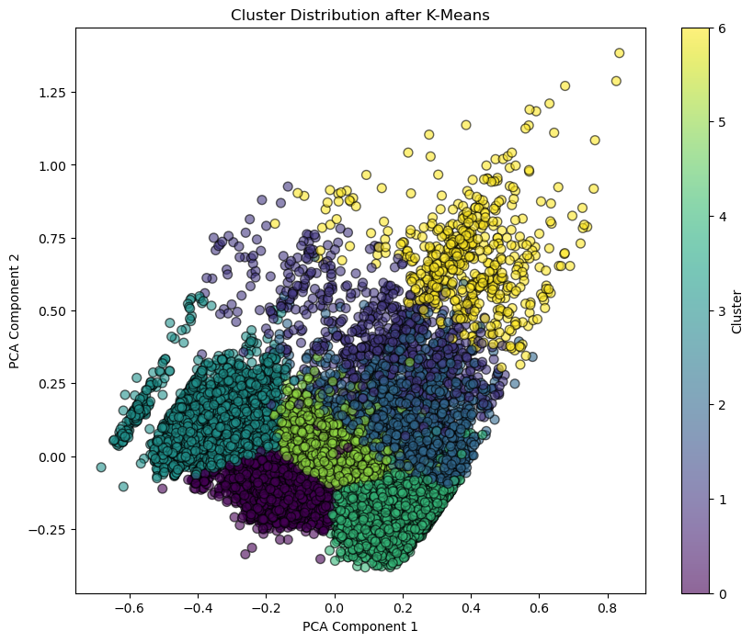
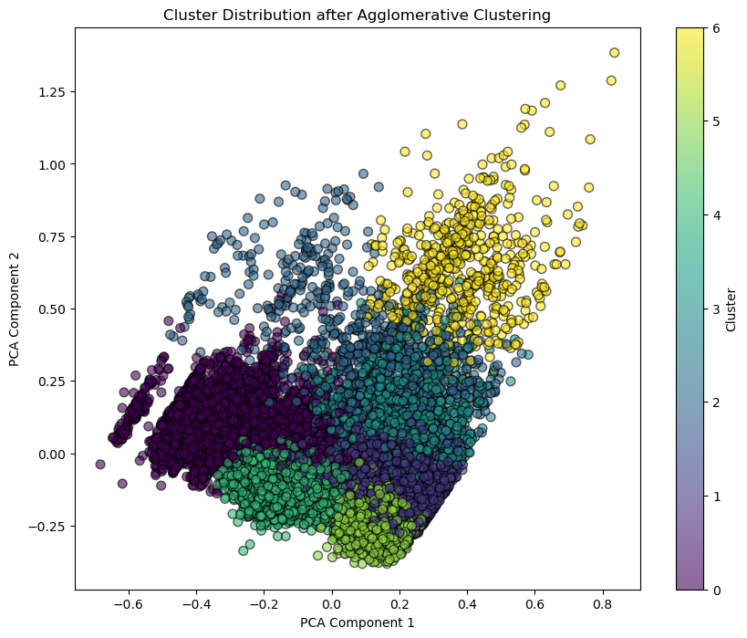
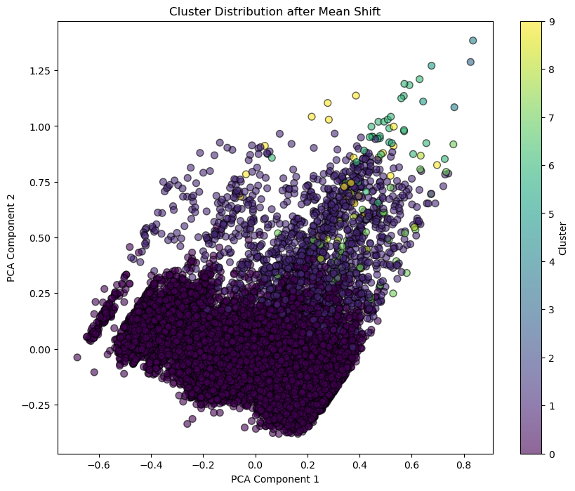
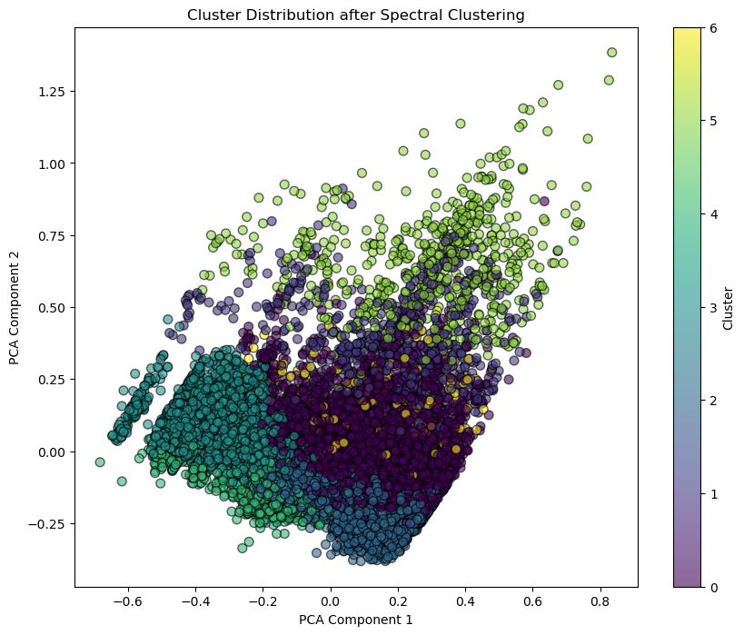
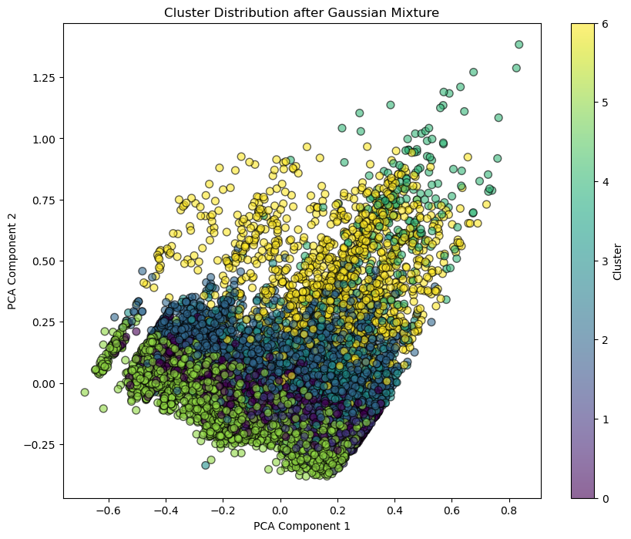
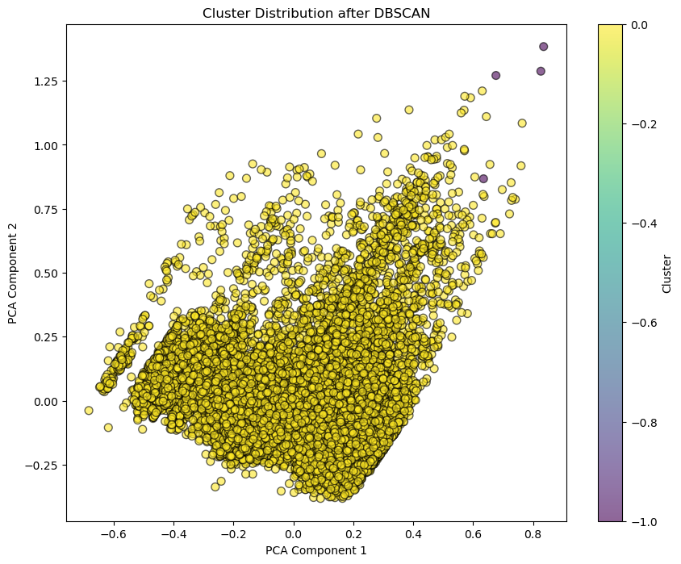
Clustering model selection
K-mean
Agglomerative
Tried Clustering Methods:
K-mean
Mean Shift
GMM
DBSCAN
Spectral
Agglomerative
Num of Cluster: 7
Mean Shift
Spectral
GMM
DBSCAN
Choose the better 3 of several models

Slide 23
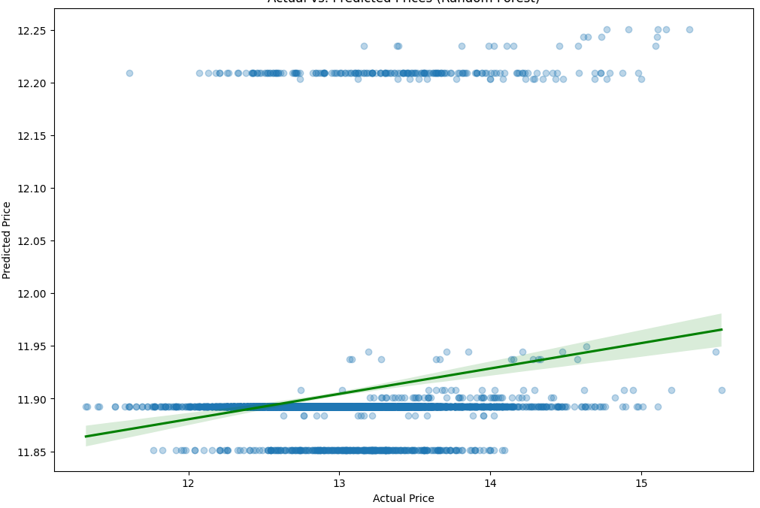
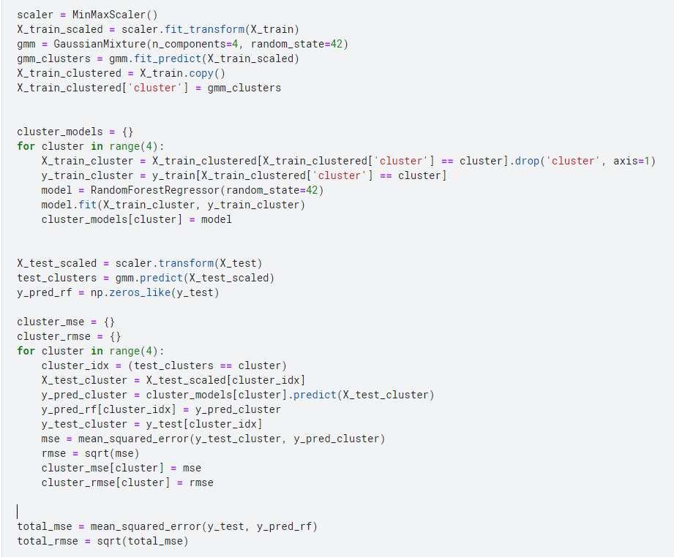
Gmm with RF&XGB
Real vs Model
GMM – RF&GM code
MSE & RMSE

Slide 24
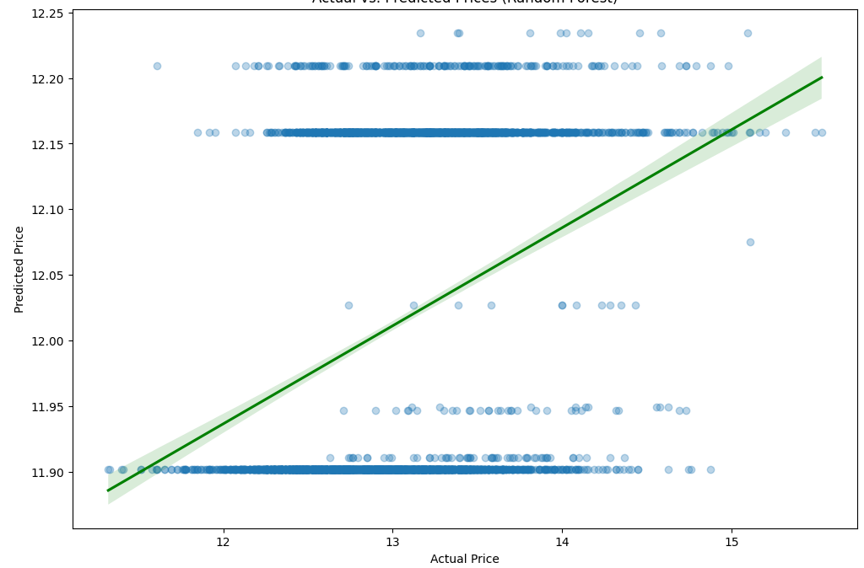
K-means with RF&XGB
K-mean – RF&GM code
Real vs Model
MSE & RMSE

Slide 25
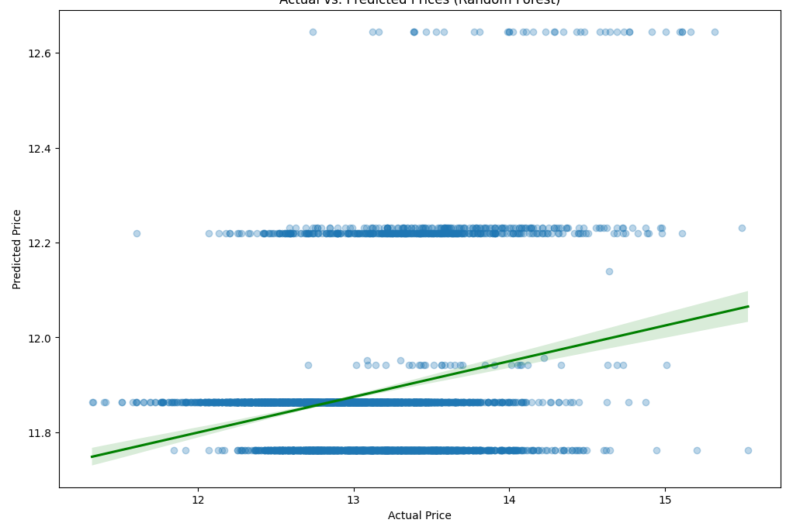
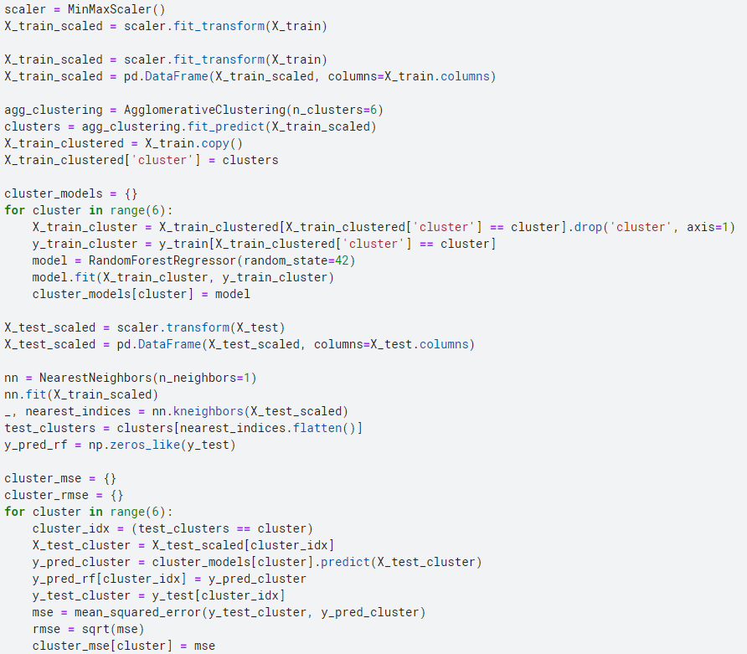
Agglomerative with RF&XGB
Agglomerative – RF&GM code
Real vs Model
MSE & RMSE

Slide 26
Comparison
GMM / K-means / Agglomerative
Number of clusters - RMSE
Num of cluster
Using Cluster & None Cluster

Slide 27
Discussion
When looking at the MSE value and RMSE value of the data, it was confirmed that the result through Random forest was the best, and when only the RMSE value was compared, XGB could also obtain a sufficiently significant value. However, it was confirmed that the method through Support Vector Regression was not suitable for the data.
When the model was implemented without clustering, the results came out better than when clustering was performed. The only difference is the amount of data because the same parameter and data were used.
This means that the data we currently used was a small number of data to proceed with clustering, and it can be confirmed that clustering preprocessing is inefficient in interpreting a small amount of data.

